Slide 1
PARKING MANAGEMENT SYSTEM

Slide 2
TABLE NAME : ADMIN
FIELD | DATA TYPE | SIZE | CONSTRAINT
admin id | Int | 10 | Primary key
Username | varchar | 30 | Not null
Password | Varchar | 30 | Not null

Slide 3
TABLE NAME : CUSTOMER
FIELD | DATA TYPE | SIZE | CONSTRAINT
Customer id | Int | 10 | Primary key
Name | Varchar | 30 | Not null
Mobile number | Int | 10 | Not null
Password | Varchar | 20 | Not null
Vehicle | Varchar | 20 | Not null
Rc number | Varchar | 20 | Not null
Address | Varchar | 30 | Not null

Slide 4
TABLE NAME : SLOT
FIELD | DATA TYPE | SIZE | CONSTRAINT
Slot id | Int | 10 | Primary key
Slot name | Varchar | 30 | Not null
total | Int | 5 | Not null

Slide 5
TABLE NAME: IN/OUT
FIELD | DATA TYPE | SIZE | CONSTRAINT
In/out id | Int | 10 | Primary key
Customer id | Int | 10 | Foreign key
Slot id | Int | 10 | Foreign key
In time | Date | 10 | Not null
Out time | Date | 10 | Not null

Slide 6
TABLE NAME: BILLING
FIELD | DATA TYPE | SIZE | CONSTRAINT
Bill id | Int | 10 | Primary key
Slot id | Int | 10 | Foreign key
Customer id | Int | 10 | Foreign key
Token number | Int | 5 | Not null
In time | Date | 10 | Not null
Out time | Date | 10 | Not null
amount | Int | 5 | Not null

Slide 7
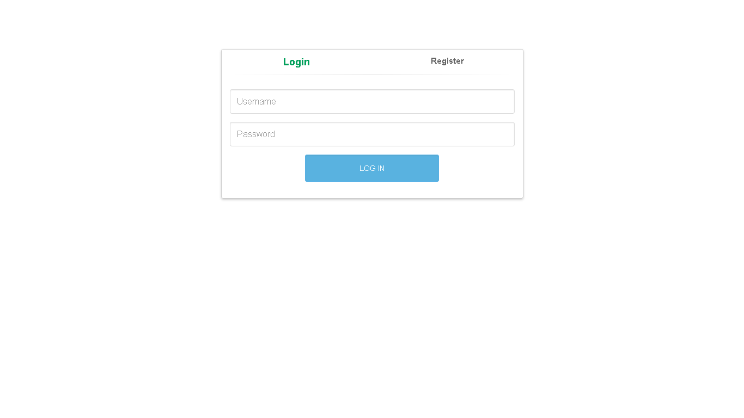

Slide 8
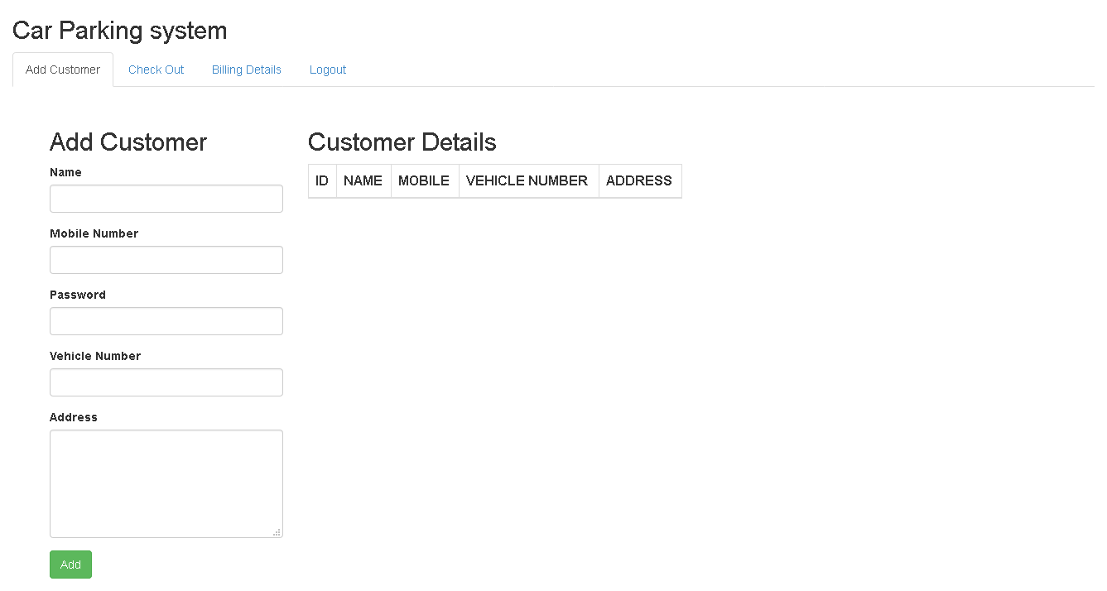

Slide 9
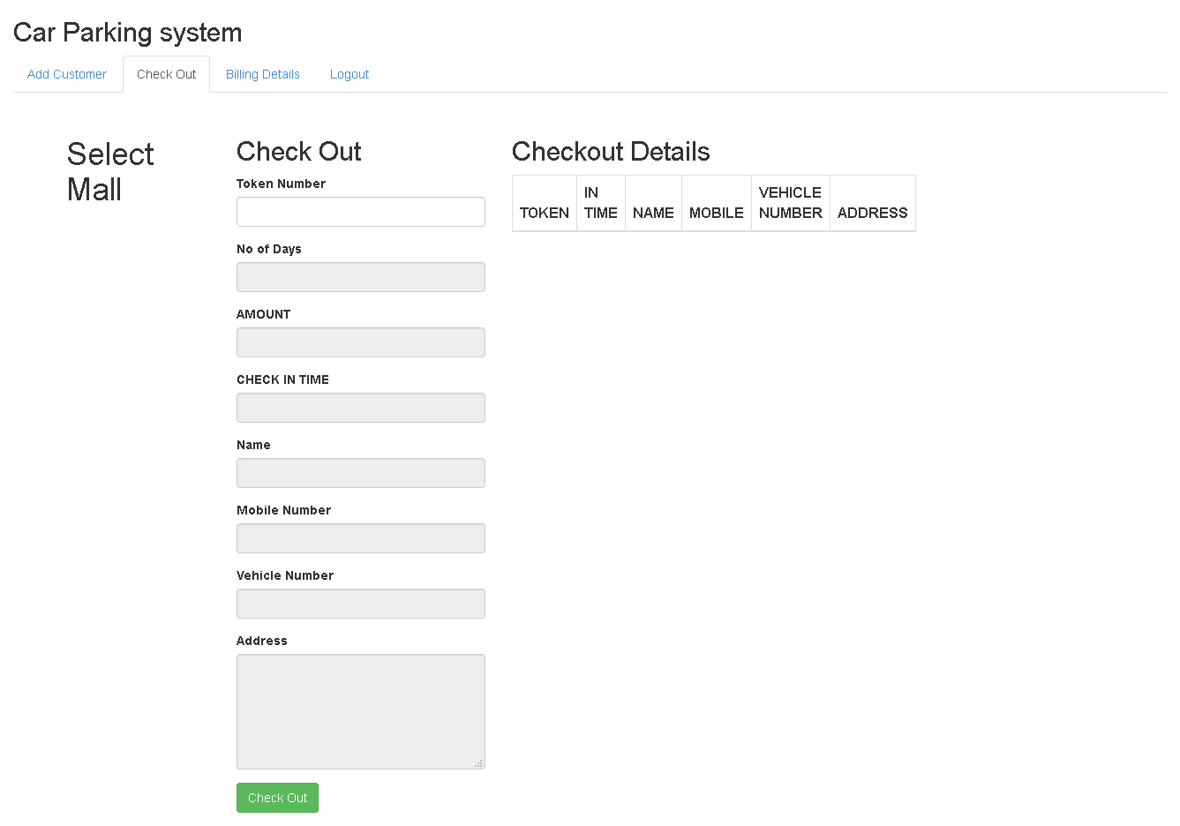

Slide 10
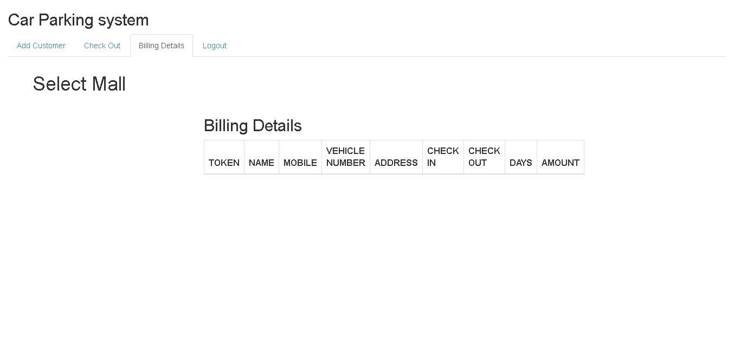

Slide 11
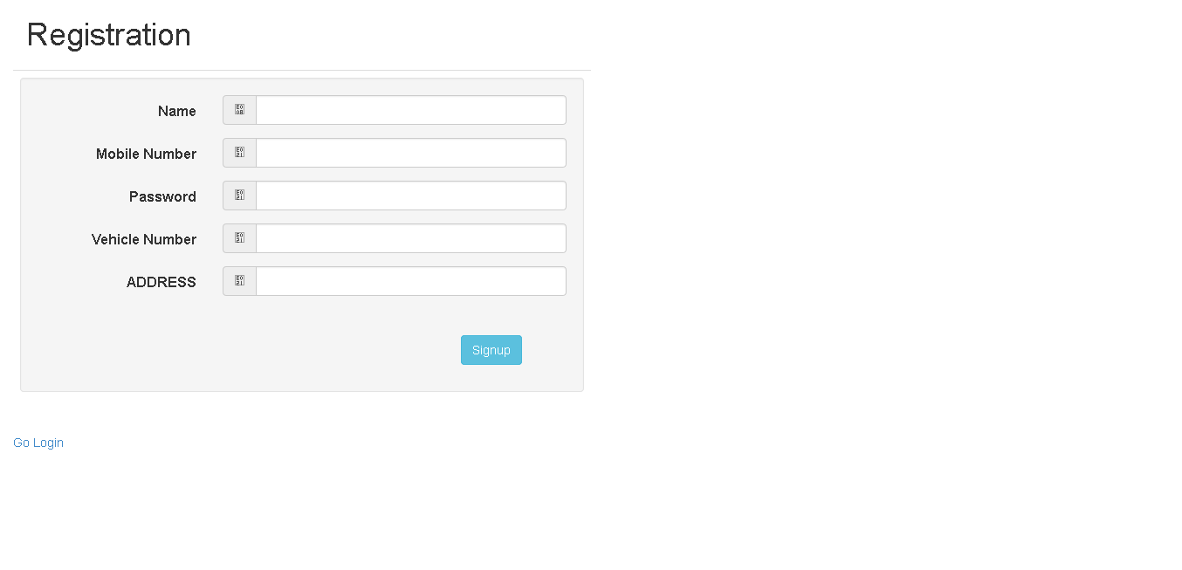

Slide 12
Thank You

